Slide 1


DISEASE PREDICTION USING MEDICAL DATA
Bachelor of Technology
(Computer Science & Engineering)
Guru Nanak Dev Engineering College

Slide 2
Outline
Introduction To Project.
Project Objectives.
Existing System.
Proposed System.
Software Requirements.
Hardware Requirements.
Snapshots of system.
Snapshots of Database table.
Conclusion.
Future Scope.

Slide 3
INTRODUCTION TO PROJECT
There are many tools related to disease prediction. But particularly heart related diseases, tuberculosis, malaria have been analysed and risk level is generated. But generally there are no such tools that are used for prediction of general diseases. So Disease Predictor helps for the prediction of the general diseases Prediction and diagnosing of disease become a challenging factor faced by doctors and hospitals both in India and abroad. In order to reduce the large scale of deaths from disease, a quick and efficient Prediction technique is to be discovered. To develop a software with the help machine learning algorithm which can help doctors to take decision regarding both prediction and diagnosing of disease. The main objective of this project is predicting the disease of a patient using machine learning algorithms.

Slide 4

PROJECT OBJECTIVES
To find the rate of disease in human beings.
To measure the probability of a user for having disease.
To implement rule based algorithm as prediction technique into a system.
To predict whether a person will have disease or not using machine learning algorithm.
To Represent and measure the variation of each factor responsible for disease.

Slide 5
EXISTING SYSTEM
Though there are many existing systems, but those seems to be very expensive as if a user wants a regular check-up then hospitals are quite expensive. So better system instead of that can be disease prediction machine which is developed and modified using python language. so, it can give an idea to the user that he will face disease in near future or not. Through this user can regularly check disease just to get a rough idea without wasting a huge amount of money in hospitals.

Slide 6
PROPOSED SYSTEM
The aim of the proposed system is to develop a system of improved facilities. The proposed system can overcome all the limitations of the manual assessment system. The system provides proper security and reduces the manual work. The existing system has several disadvantages and many more difficulties to work well. The proposed system tries to eliminate or reduce these difficulties up to some extent. The proposed system will help the user to sustain in market increasing rapidly and reduces mental conflict. The proposed system helps the doctors to work user friendly and he can easily do his jobs without time lacking.
Notes:
When the EEG is measured using non-invasive electrodes arrayed on an individual’s scalp it is referred to as scalp EEG; and when it is measured using electrodes placed on the surface of the brain or within its depths it is referred to as intracranial EEG.
The EEG is a multichannel recording of the electrical activity generated by collections of neurons within the brain.
Different channels reflect the activity within different brain regions.
The scalp EEG is an average of the multifarious activities of many small zones of the cortical surface beneath the electrode.

Slide 7
SOFTWARE REQUIREMENTS
About Operating System: Windows XP or Later.
Windows 7 or later
Linux / Ubuntu (Excluding Kali Linux)
Python Version 3.5 or more

Slide 8
HARDWARE REQUIREMENTS
Pentium 4 Computer (Minimum)
512 MB RAM (Minimum)
Hard Disk - 40GB (Minimum)

Slide 9
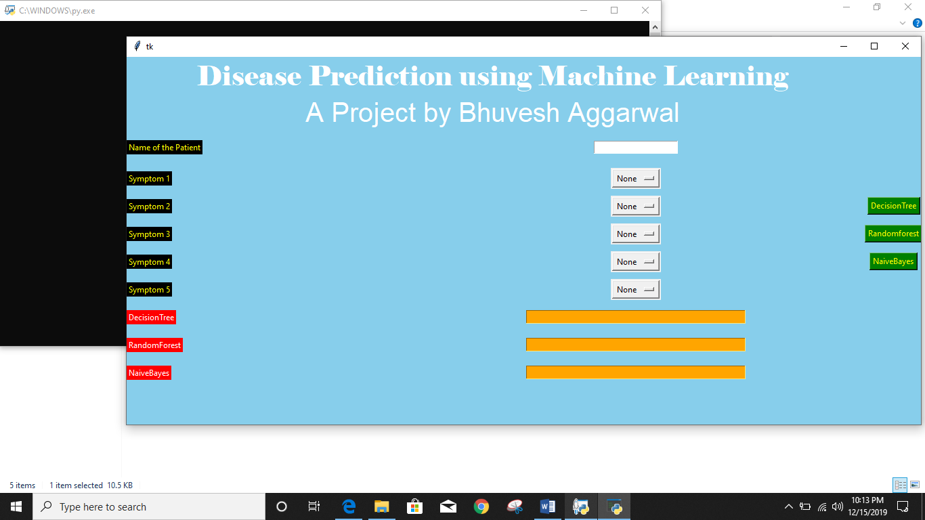
SNAPSHOTS OF SYSTEM

Slide 10


Slide 11

Notes:
Support vectors: data points closest to the hyperplane

Slide 12


Slide 13
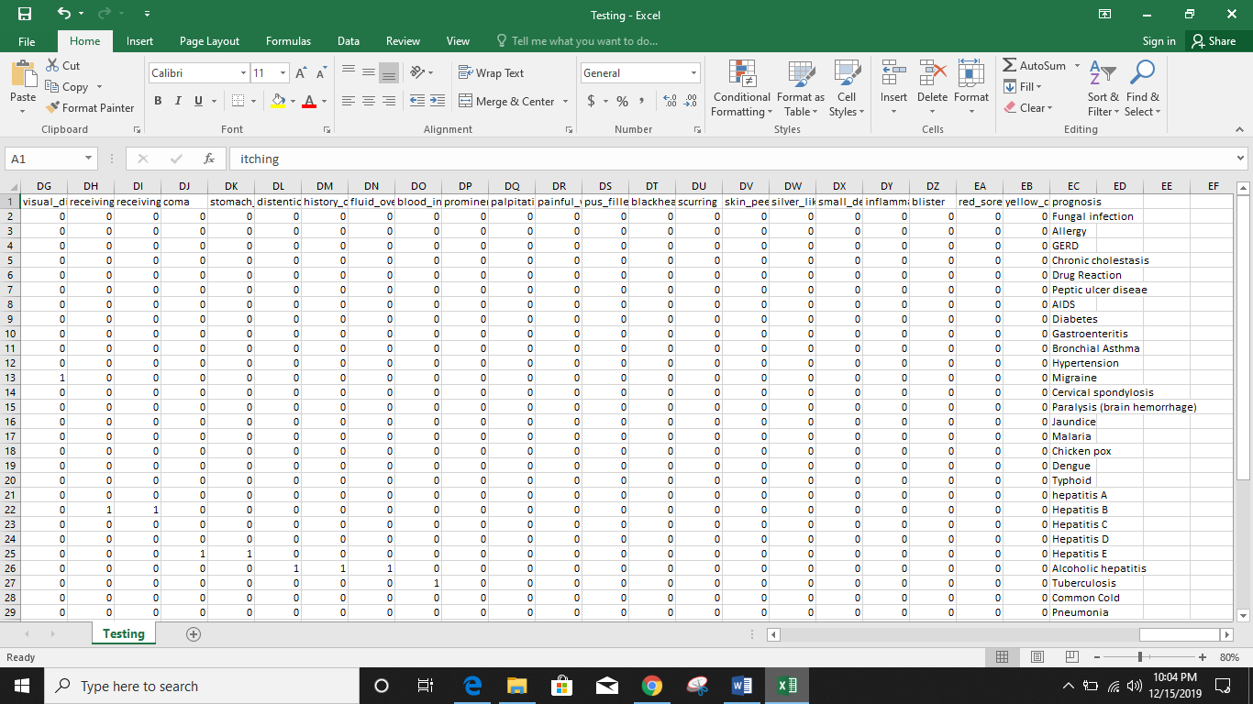
SNAPSHOTS OF DATABASE TABLE

Slide 14
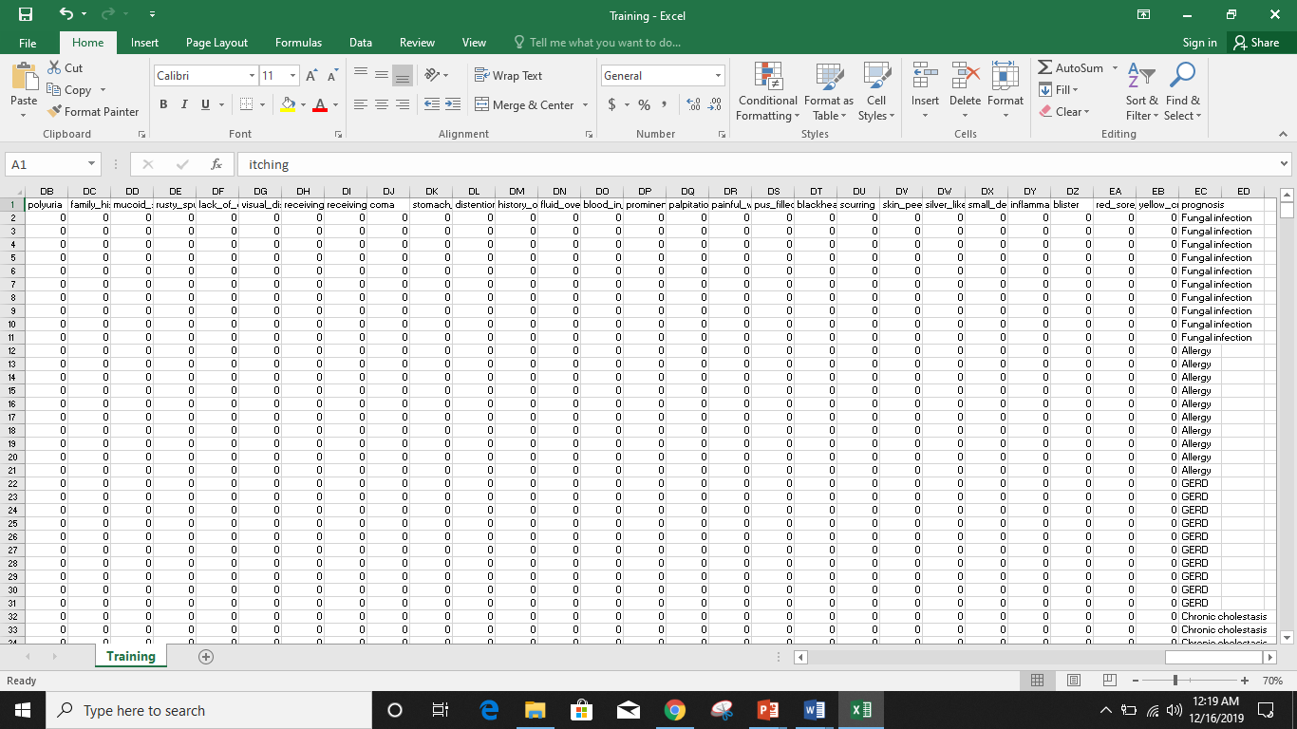
Trained and Tested Data

Slide 15
Conclusion
Machine learning has the great ability to revolutionize the disease risk prediction with the help of advanced computational methods and availability of large amount of epidemiological and genetic disease risk dataset. Detection of disease in its early stages is the key for treatment. This work has described a machine learning approach to predicting disease levels. The technique may also help researchers to develop an accurate and effective tool that will reach at the table of clinicians to help them make better decision about the disease status.

Slide 16
Future Scope
As no application is perfect so there are certain amendments in every application with passage of time, so there will be big need for the updates in this application also. This is a rich topic to work on and a lot of further work can be done to improve the efficiency of this project in terms of both speed and accuracy. Moreover, using deep learning, AI systems can be created that can predict the onset of disease well before a patient is diagnosed with it. As far as the code is concerned, it is running properly. In future the disease attributes should be more refined and list of added symptoms may be increased more for more accurate result for prediction for the diseases. And not only cancer, heart disease, arthritis, other general diseases should also be taken care of for earlier detection.
Notes:
muscle force is closely related to the amplitude of EMG signals

Slide 17


